Slide 1
IBM CAPSTONE PROJECT
The Battle of Neighbourhoods :
search for the best situation if I want to visit the capital of a country in the world.

Slide 2
Business Problem section :
I propose to simulate a search for the best situation if I want to visit the capital of a country in the world.
I did a search on google so as not to be biased in the choice of monuments to discover in each capital. My research is therefore: the name of a capital + «tourist places» I had these results for these four cities : Paris, Washington, Rome, Lenders.

Slide 3
Data of Paris Capital

Slide 4
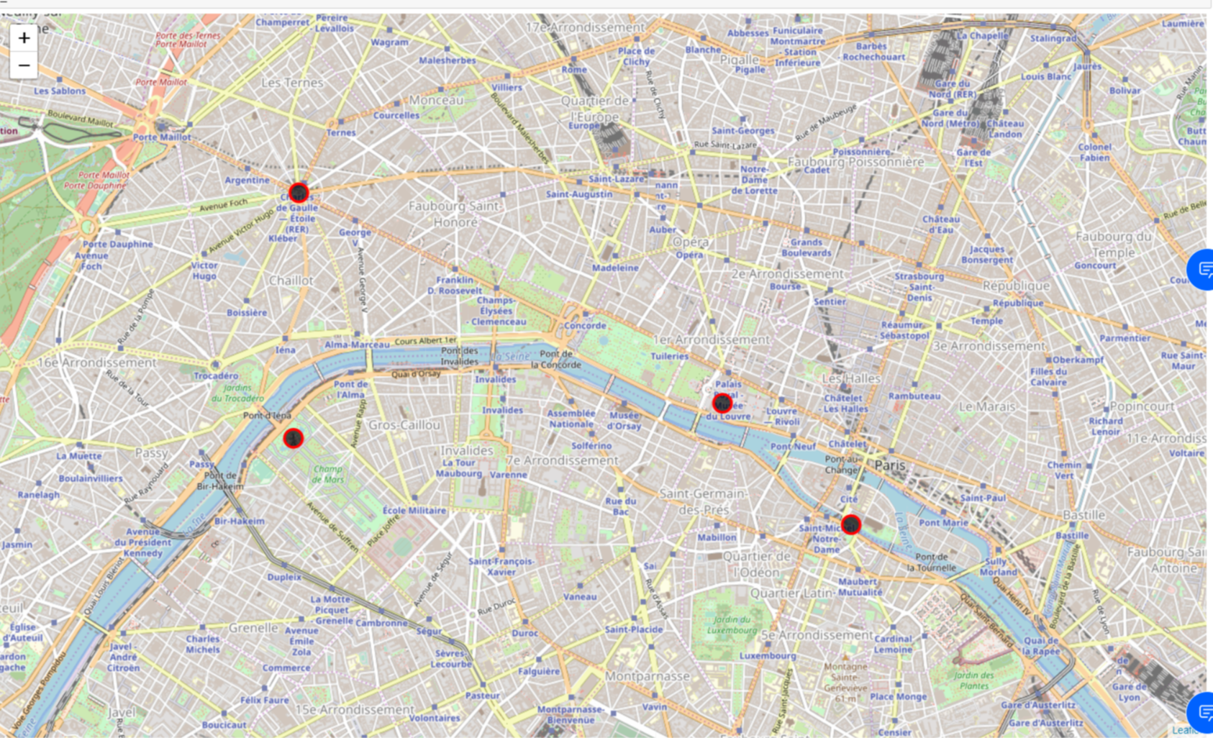

Slide 5
K- means clustering

Slide 6
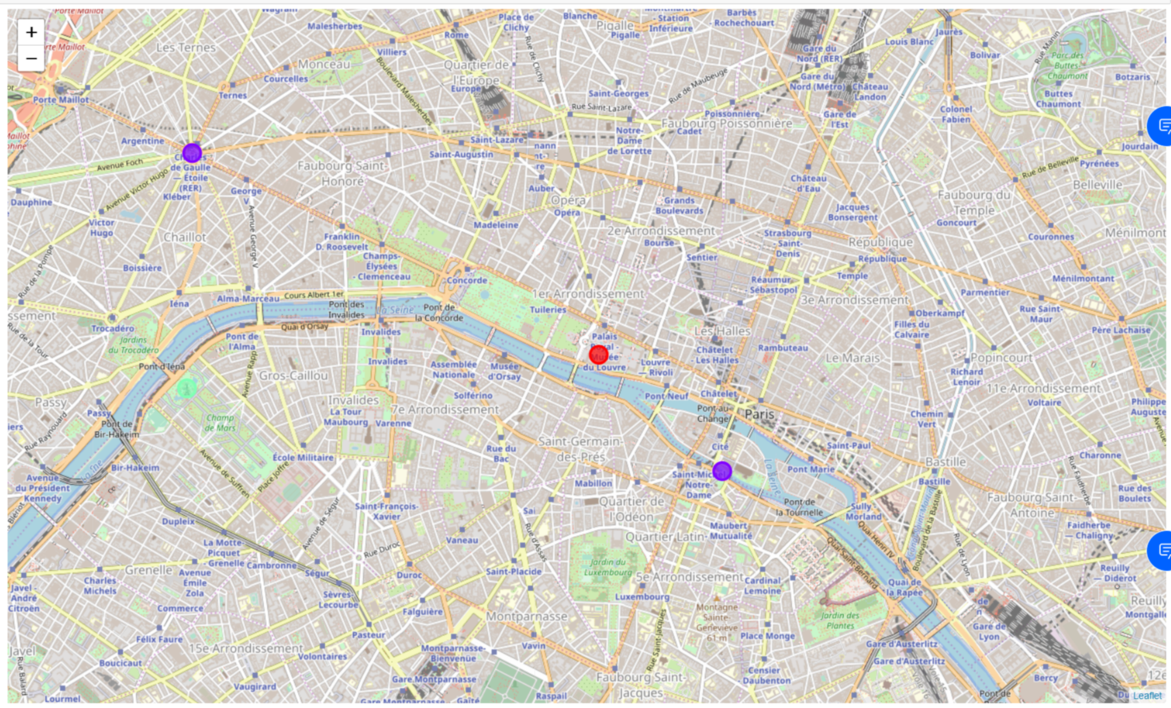

Slide 7
Thank YOU

